Slide 1
« Programme D’Analyse Des Systèmes Educatifs de la CONFEMEN » (PASEC) PASEC Contextual questionnaires Washington DC 8-11 April

Slide 2
1. Introduction to CONFEMEN and PASEC
CONFEMEN: Conférence des Ministres de l’Education des Etats et Gouvernements membres de la francophonie (44 countries)

Slide 3
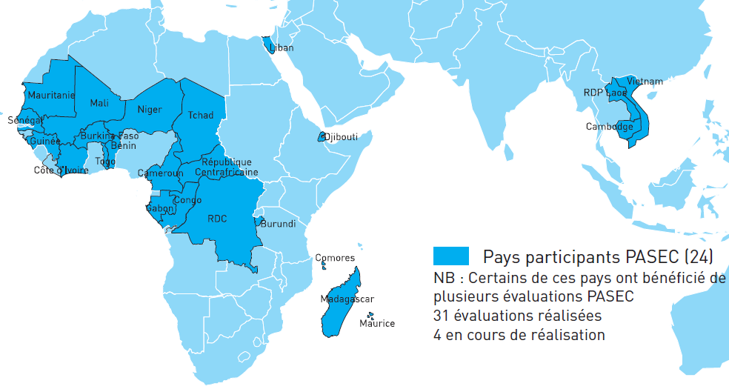
PASEC :
The Programme d’Analyse des Systèmes Educatifs de la CONFEMEN (Education Systems Analysis Program) has been created in 1991. For the past 20 years the PASEC has been running National and Thematic Evaluations under countries’ requests. Since 2012, the PASEC has set up a new framework for international comparative evaluations in 10 African countries.

Slide 4
PASEC CONTEXTUAL QUESTIONNAIRE
Student questionnaire
Teacher questionniare
School questionnaire (principals)

Slide 5
Student questionnaire
General informations
Living conditions (goods, etc.)
Nutrition
Others

Slide 9
Teacher questionnaire
INDIVIDUAL CHARACTERISTICS
ACADEMIC AND PROFESSIONAL TRAINING FORMATIONS
STATUS AND PAYMENT
CLASS ORGANISATION
CLASS EQUIPMENTS
SOCIAL ENVIRONMENT
PEDAGOGIC ASPECTS
RELATIONSHIP
OTHERS

Slide 10
Teacher questionnaire
INDIVIDUAL CHARACTERISTICS
Include : gender, age, etc.
ACADEMIC AND PROFESSIONAL TRAINING FORMATIONS
Highest class, highest qualification, pedagogic, etc.
STATUS AND PAYMENT
Status, bracket salary

Slide 17
Principals questionnaires
INDIVIDUAL CHARACTERISTICS
ACADEMIC AND PROFESSIONAL TRAINING
ORGANISATION AND IDENTIFICATION OF THE SCHOOL
RELATIONSHIP WITH PARENTS AND SOCIAL ENVIRONNEMENT OF PUPILS
SCHOOL MANAGEMENT
OTHERS

Slide 23
Thanks you
www.confemen.org
pasec@confemen.org

